Slide 1
SIST_SI100B_RoboWriter
Project Report
丁宁 姜泊含 马睿奕 Group ID：2

Slide 2
Catalogue
Ⅰ.Project Background and Application scenario
Ⅱ.Research objectives and work contents
Ⅲ.System Design and project implementation
Ⅳ.Testing and Results
Ⅴ.Problems and Possible Improvements
Ⅵ.Conclusion

Slide 3
Ⅰ.Project Background and Application scenario
Project Background: Utilizing the Mujoco physics engine, the ur5e robotic arm is employed to perform the writing of input characters.
Application scenario: Enables flat and three-dimensional writing for single or multiple characters. Further options include selecting the size of the writing area and the type of font.

Slide 4
Ⅱ.Research objectives and work contents
Research objective: Utilize tools such as OpenCV to capture and write character shapes
Job Description: Write programs to enable the recognition of character outlines, and then convert them into data formats that can be recognized by Mujoco. Finally, reproduce the characters in Mujoco.

Slide 5
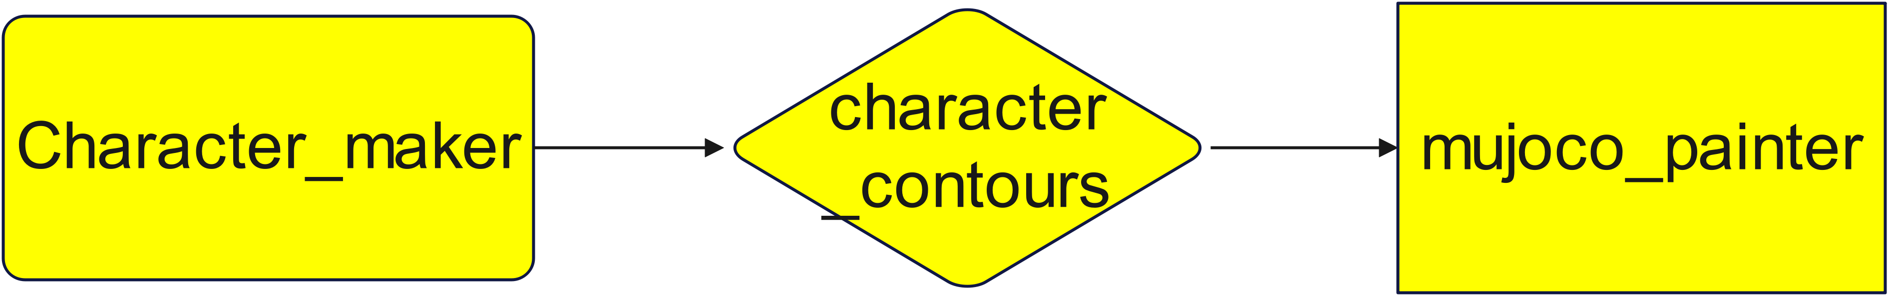
Ⅲ.System Design and project implementation
Character_maker: A contour generation tool based on OpenCV and Bezier curves ,whcan store the contours of the given characters in the "character_contours" folder with the form of grid coordinates
Character_contours: A folder containing the coordinates of the grid points, which can be read by “mujoco_painter”
mujoco_painter: This part can import the coordinates into the mujoco program and subjected to linear fitting and IK calculations, so as to visualize and output the string.

Slide 6
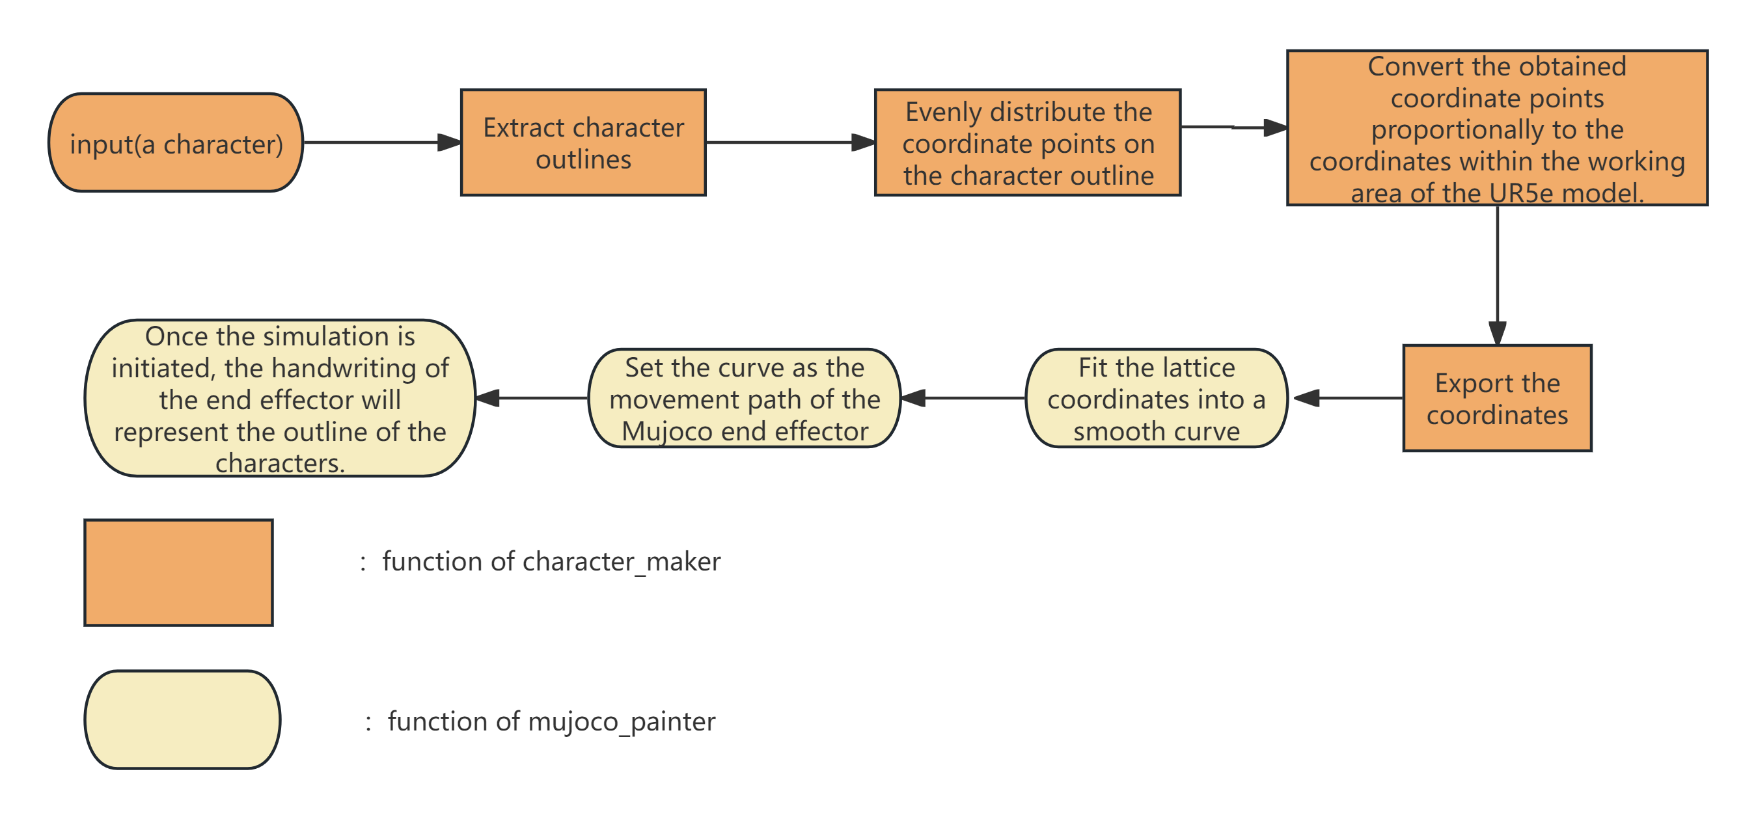
Ⅲ.System Design and project implementation

Slide 7

Ⅲ.System Design and project implementation
Key Technologies and Solutions(Character_maker):
1. How to find the outline of a character?
Solution:
Use Opencv(Func：cv2.findContours)
If findContours failed to accurately identify the outline (this issue occurs when the characters are too complex),we use function cv2.Cannys to ensure the outline is indentified correctly.
2.How to ensure that the character outlines are accurately extracted by points?
Solution:
Ⅰ.Convert the grayscale image to a black-and-white binary image to facilitate contour extraction.
Ⅱ.Filter out the tiny contours with an area less than 5 (mostly image noise points), and only retain the contour of the valid character strokes.
Ⅲ.Allocate the number of sampling points according to the contour length(Contour resampling), to ensure that there is no situation where some contours have too many points while others have too few points.
#contours with too many points may be over-fitted in the subsequent Bezier fitting, and contours with too few points will have poor fitting results, resulting in image distortion
Ⅳ.Set up the final verification. If the results are not compliant, recalculate the fitting results.

Slide 8
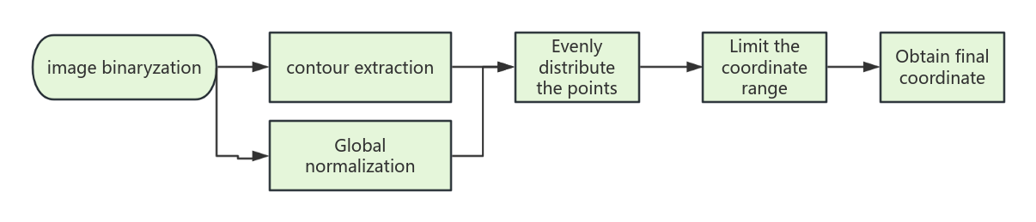
Detailed explaination of Opencv using
extract_contour_points:Use OpenCV to extract character outlines(core function)
image binaryzation:Divide the image into black and white, enhance the contrast, and make it easier for OpenCV to recognize.
contour extraction:Keep all the points of the contour, and normalize them to facilitate the subsequent limitation of the character coordinates within the working range of the ur5e robotic arm.
#Perform canny edge detection to extract contours in partially connected characters
Evenly distribute the points:Remove the noise points and obtain the final coordinates.
Final result:After sampling each contour separately and assigning point numbers, the resulting coordinate point array is combined, which constitutes the coordinate point array of the overall contour of the character.

Slide 9
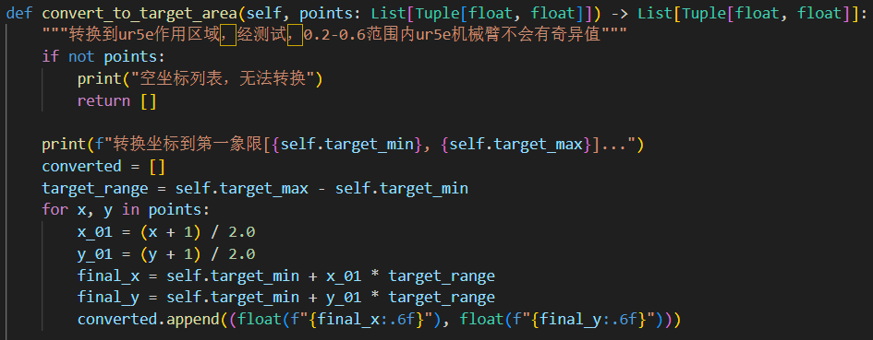
Ⅲ.System Design and project implementation
Key Technologies and Solutions(Character_maker):
3.How can we ensure that the UR5e robotic arm can accurately identify the coordinates it has taken?
Solution:Use the coordinate transformation formula
Since the patterns of x and y are the same, only x is presented here.
Why we chose [0.2-0.6]?
x | 0.1 | 0.2 | 0.3 | 0.4 | 0.5 | 0.6 | 0.7 | 0.8
Mutation? | not sure | no | no | no | no | no | not sure | yes
Not sure:Means related to the value of Y.The closer the coordinates are to the origin, the more likely they are to undergo a sudden change.(possible reason:When the end effector approaches the origin, the joint undergoes an approximately 360-degree bending, resulting in a sudden change.)
So we limited the range of coordinate into [0.2,0.6]

Slide 10
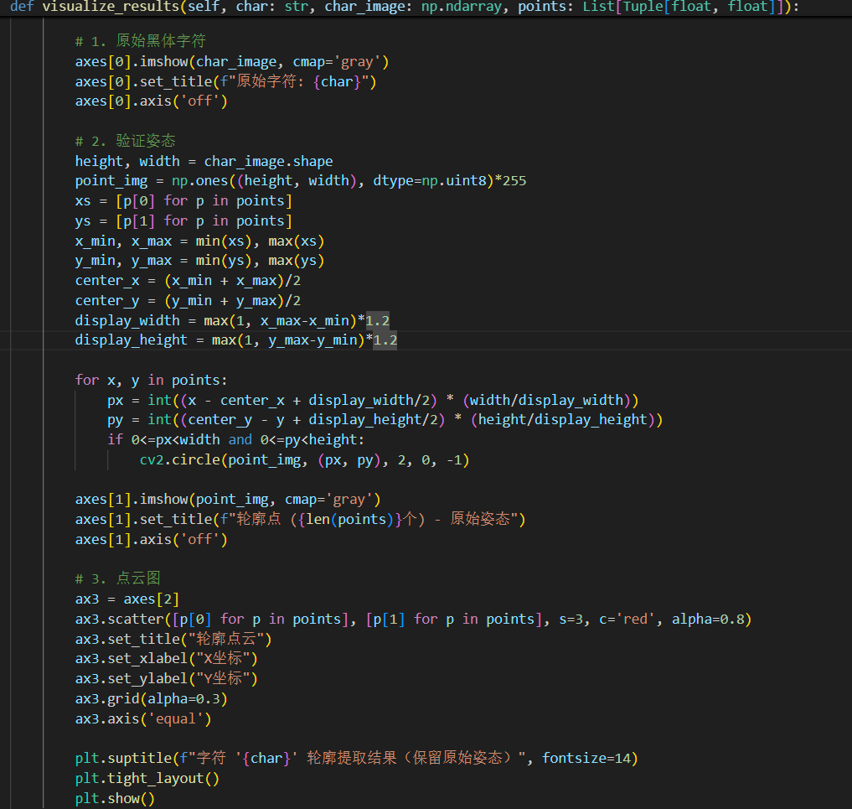
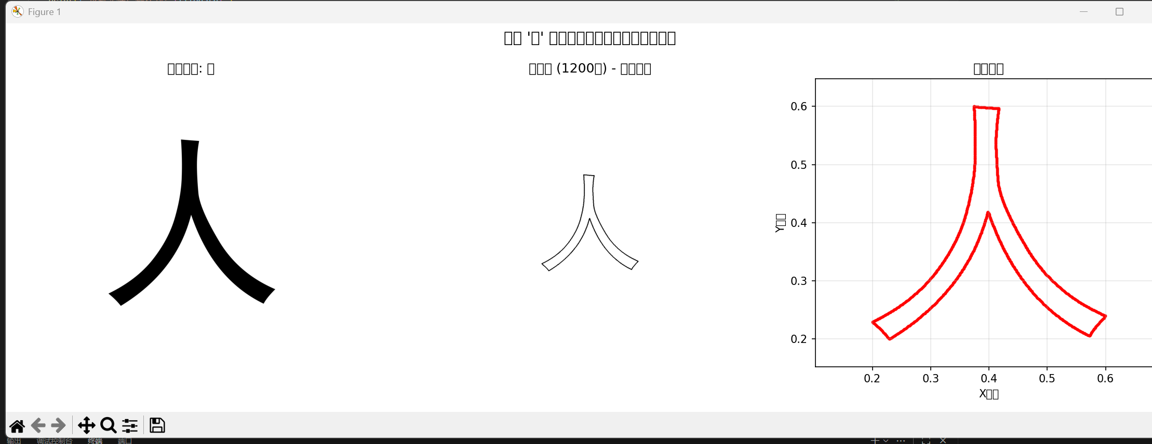
Ⅲ.System Design and project implementation
Visualization tools(Character_maker):
In order to make the output of the coordinates more intuitive and make debugging easier, we used the visualization tool Matplotlib.
The output of this program consists of three items: the original grayscale image(left), the reconstructed contour point image(middle), and the dot matrix cloud map(right).
They are respectively used to verify:
whether the original image is correct; whether the contour points can be restored to character contours; and whether the dot matrix is properly attached to the contour points.

Slide 11
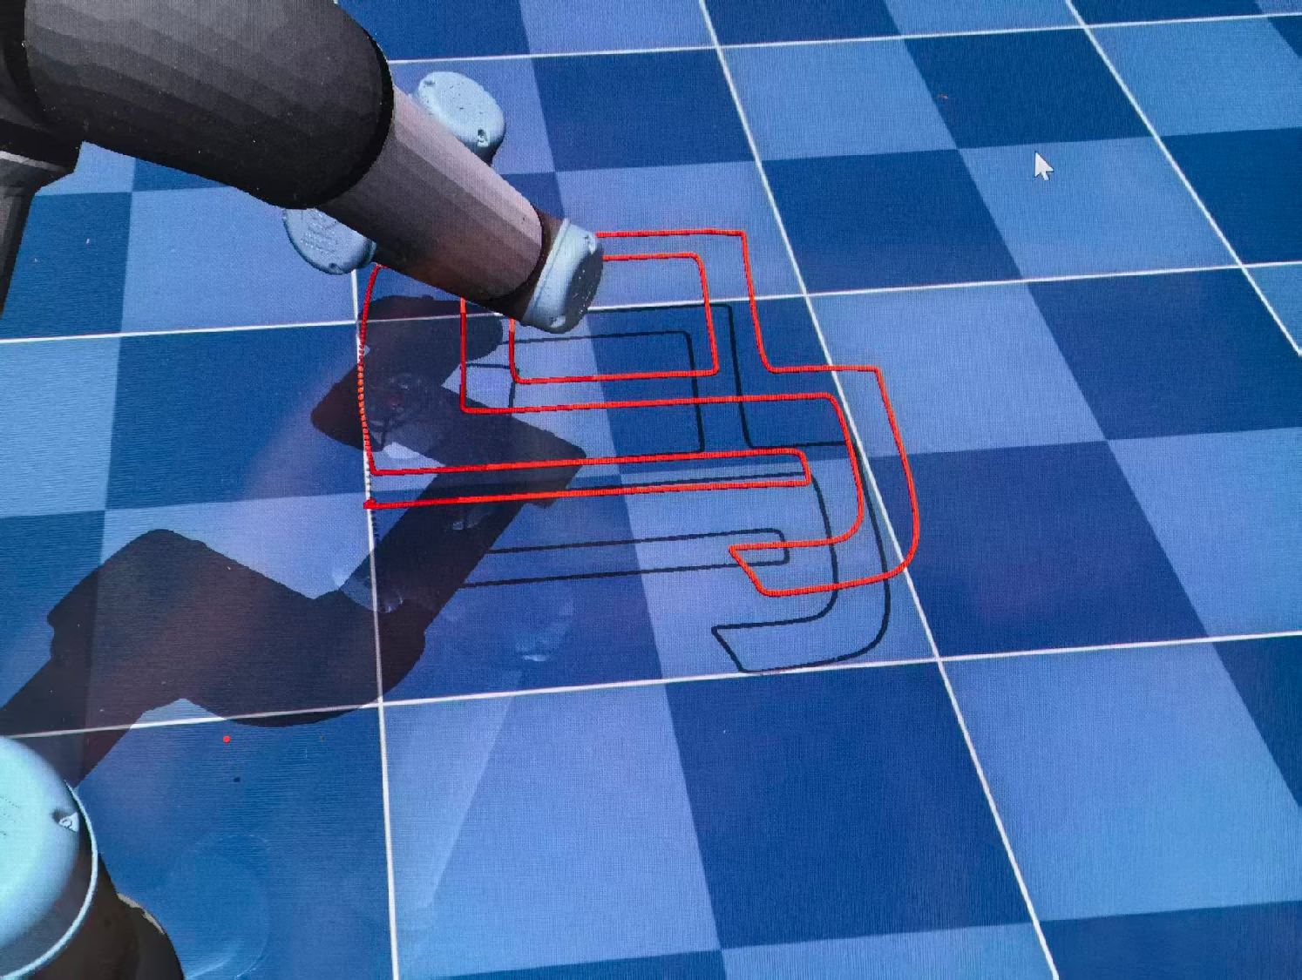
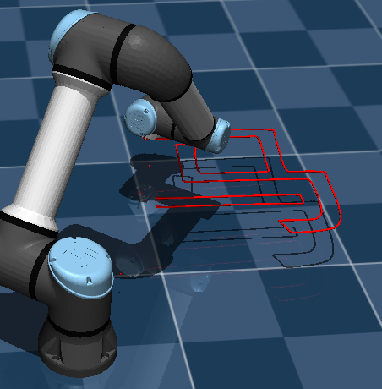
Ⅲ.System Design and project implementation
Key Technologies and Solutions(mujoco_painter):
Our program has been improved based on the sample program. While retaining the original Bezier interpolation and coordinate reading logic, we have also enhanced the applicable conditions for Bezier/linear fitting, and added the lifting/stylus-down mechanism.
Before improvement
(There is a clear connection on the left side)
After improvement

Slide 12
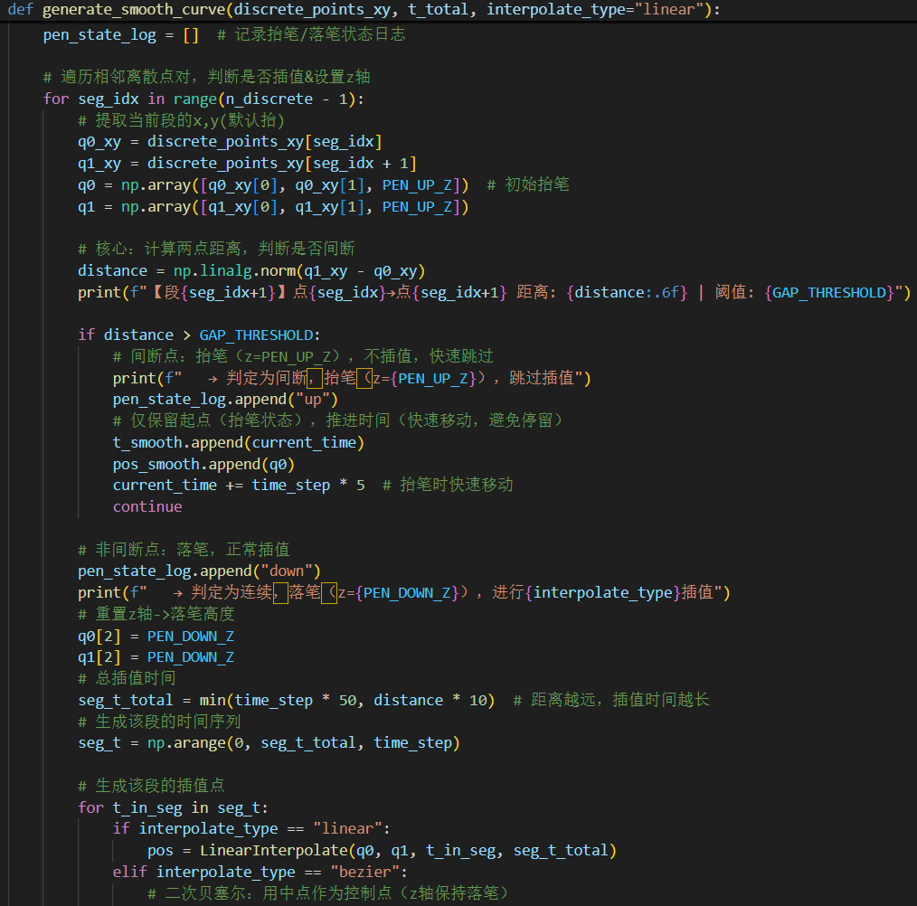
Ⅲ.System Design and project implementation
Key Technologies and Solutions(mujoco_painter):
In previous tests, we found that the previous Bezier function would connect strokes that were not supposed to be connected. Therefore, we added a pen-up and pen-down judgment mechanism: when the distance between the two initial coordinate points is greater than a certain value, it is identified as a pen-up point and no interpolation processing is performed.

Slide 13
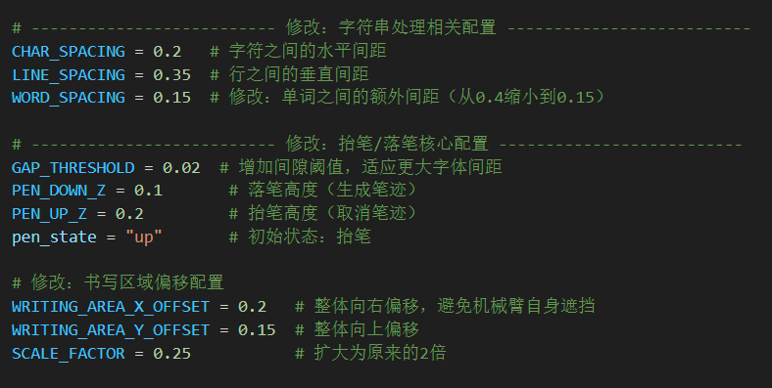
Ⅲ.System Design and project implementation
Key Technologies and Solutions(muti-character):
The previous two programs could handle any single character, but were limited in handling multiple characters. Therefore, we retained the original algorithm and integrated the two programs into a new program that can handle multiple characters as well as reproduce them in mujoco.
While ensuring that the robotic arm does not experience any jerking, by adjusting the target range of coordinate scaling, the function of being able to write multiple characters simultaneously was achieved.
Using tips:First, import the coordinates of the required characters into the target folder using "character_maker", then select the specified folder with "multi-character". "Multi-character" will automatically match the required coordinates based on the ASCII code.

Slide 14
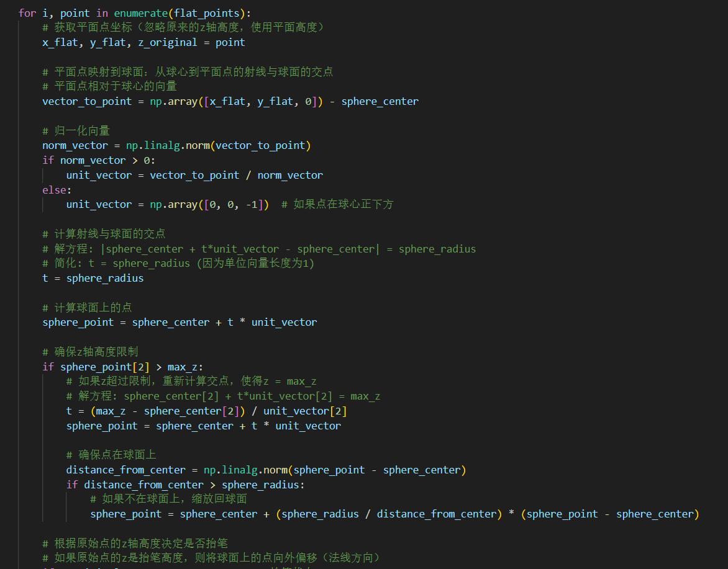
Ⅲ.System Design and project implementation
Key Technologies and Solutions(muti-curve-character):
Based on the multi-character method, all that is needed is to add the relevant operations of three-dimensional Euclid distance with calculation related to spatial vectors, the goal of spherical writing can be achieved.
However, due to the algorithm not being mature enough, the curvature of the surface writing does not seem to be obvious.

Slide 15
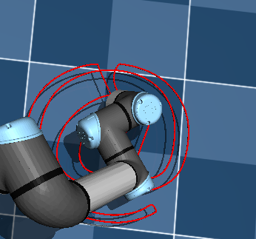
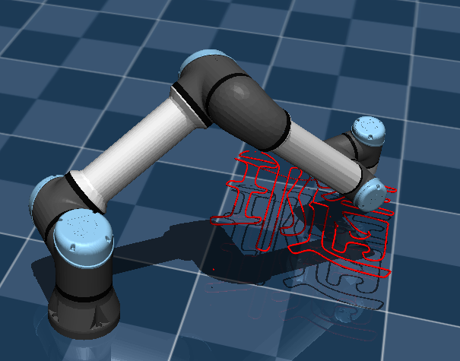
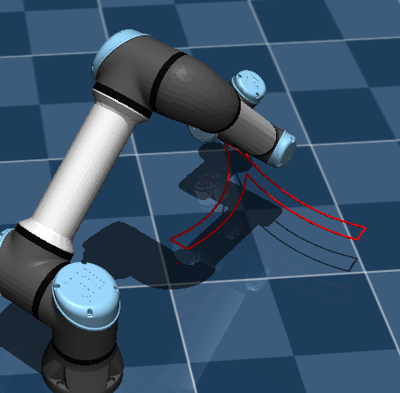
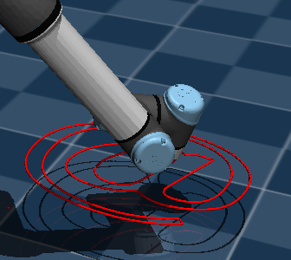
Ⅳ.Testing and Results
Test Sample 1: Rare Characters
Test Sample 2: Common Characters
Test Sample 3: Special symbols
Original input:瓍
analysis：The overall structure of the font has been replicated, but due to the excessive number of strokes, there are still some parts that are stuck together.
Original input:人
analysis：A nearly perfect reproduction
Original input:@
analysis：There is still a slight adhesion, but it can be restored to the correct shape.

Slide 16
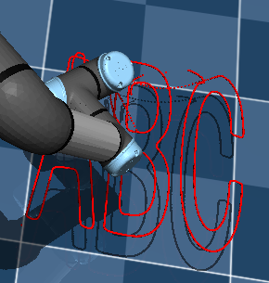
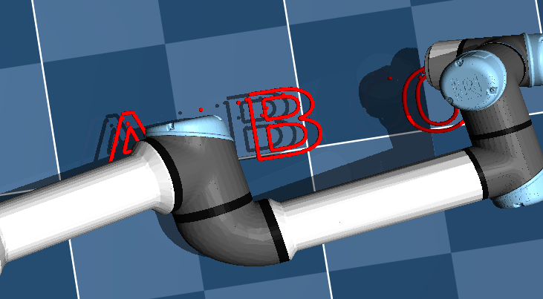
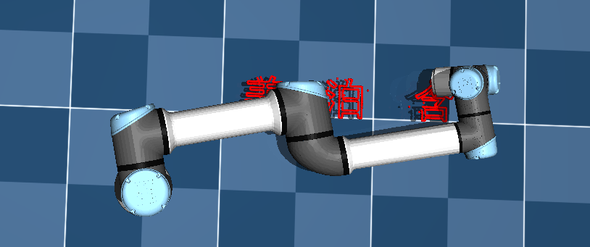
Ⅳ.Testing and Results
Test Sample 4: English
Test Sample 5: (muti-character)
Test Sample 6: (muti-character)
Original input:ABC
analysis：The adjacent parts of the letters are stuck together, which also indicates the limitations of mujoco_painter in handling multiple characters.
Original input:ABC
analysis：There is no adhesion between the letters, and there are no incorrect connections within the letters either.
Original input:姜 泊 含
analysis：All three characters can be output normally, and there is no sticking or overlapping between or within the characters.

Slide 17
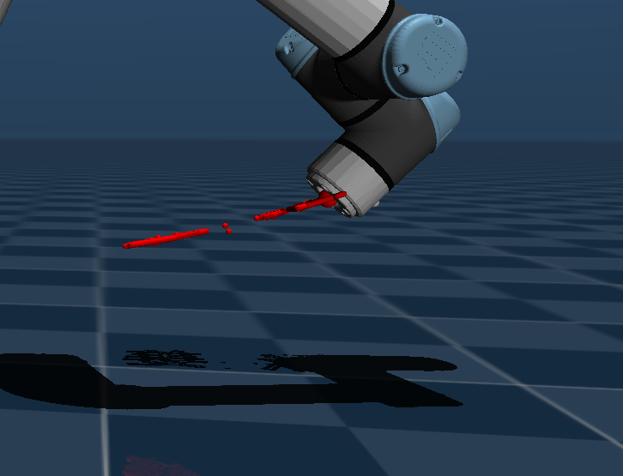
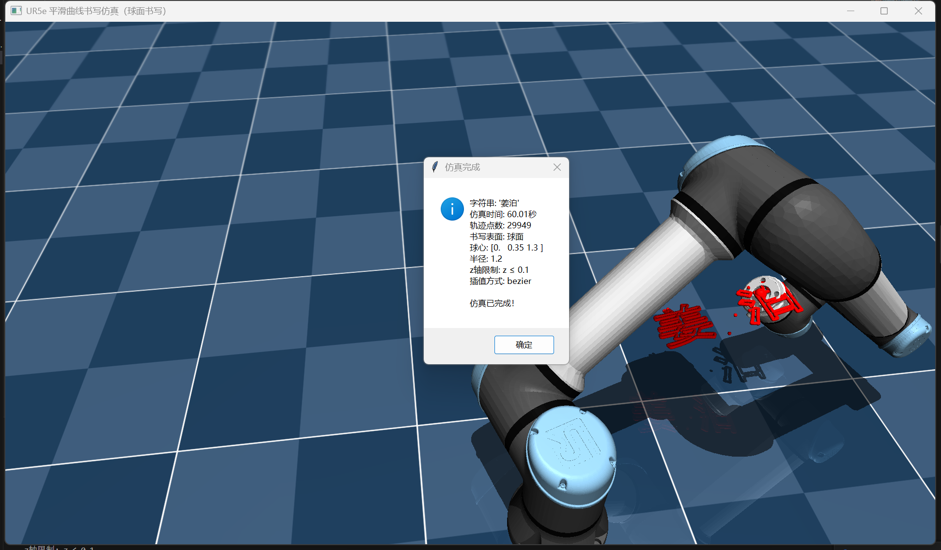
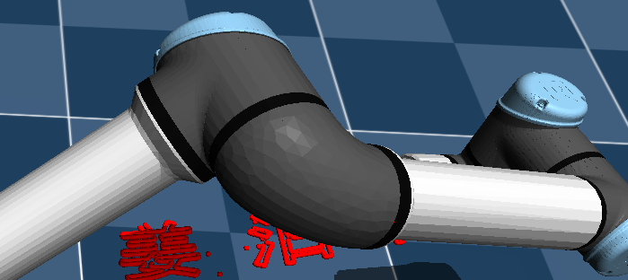
Ⅳ.Testing and Results
Test Sample 7: Curve Characters（three-characters)
Test Sample 8: Curve Characters（two-characters)
Original input:姜泊含
analysis：It can demonstrate the curvature effect, but when writing the last character, due to the setting of calculation time, there is a phenomenon of stroke loss.
Original input:姜泊
analysis：It has very well matched the curvature of the surface and completed the output.

Slide 18
Ⅳ.Testing and Results
Result Analysis:
Some characters have become stuck together - this is caused by the mujoco_painter function's incorrect interpolation of coordinate points that belong to different parts during the fitting process. However, since mujoco must perform Bezier interpolation to draw smooth curves (otherwise it would jitter), and our current Bezier interpolation algorithm cannot avoid this phenomenon.
In multi-character, this kind of connection phenomenon disappears - this is because multi-character reduces the size of the character shapes. At this time, the spacing between different parts of the character or different characters is larger compared to the connected parts of the character, so the Bezier function does not recognize it as the "part that should be interpolated", and therefore does not connect them.
However, considering the clarity and size of the font, we did not apply the multi-character algorithm to the Bezier interpolation part of individual characters. Instead of possible overlapping, we preferred to present a font that is large enough and clear enough.

Slide 19
Ⅴ.Problems and Possible Improvements
limitations:
1.Due to the fundamental principles of the algorithm, it is still impossible to completely avoid the problem of stroke connection. If different parts of a character are close to each other, the Bezier fitting in the mujoco part will incorrectly connect these different parts, resulting in stroke connection. This is more obvious in some complex characters and special characters.
2.When dealing with multi-character processing (especially when characters are separated by spaces), if the horizontal length of the string is too long, it may not be fully recognized or may be misidentified, resulting in the characters becoming elongated or partially missing.
3.When writing on a curved surface, the character shapes may change due to the deviation in the calculation of the three-dimensional Euclid distance.At the same time, due to the short calculation time and the cumulative offset of the end-effector position, bugs will occur when writing on curved surfaces with more than three characters.

Slide 20
Ⅴ.Problems and Possible Improvements
possible improvements:
1.Further improve the character scanning logic to adapt to multi-character writing
or lengthen the range of width to contain more characters.
2.Further practice and adjustment of the applicable conditions for Bezier fitting in mujoco_painter are carried out. When the distance between two interpolation points is greater than a certain specific value, the fitting will no longer be performed to avoid incorrect connection of different parts of the character.
3.Improve the function of the curved surface writing section,Extend the calculation time and add a three-dimensional vector algorithm for surface calculation.
4.Change the way of searching for characters in multi-character mode (the original method was to bind ASCII codes, which might ignore some special characters), and make it directly outline the contours using OpenCV.

Slide 21
Ⅵ.Conclusion
In this project, we successfully implemented the control of the Mujoco robotic arm joints using Python code, as well as the inverse kinematics solution for the robotic arm joints. At the same time, with the help of libraries such as OpenCV, we completed the process of reading ---- translation (converting the character outline into pixel coordinate) ---- output.
In the future, we will focus on improving the Bezier fitting algorithm while maintaining the fitting accuracy. We will attempt to combine deep learning technology instead of using a fixed precise value approach, in order to avoid the connection between characters.
Furthermore, compared to the complex and error-prone IK calculation of the UR5e robotic arm, our initial design adopted a 3D printer-style end effector. The advantage of this type of end effector lies in that it only requires the representation of two joints along the x-axis and y-axis, which can convert the lattice coordinates into the displacement of the end effector (similar to vector operations). This not only saves computing power but also reduces the complexity of the calculation.

